Slide 1
C++ is Fun – Part Five at Turbine/Warner Bros.!
Russell Hanson

Slide 2
Discussion
Please fill in the paper with two things you would like more information or clarification on that we’ve covered already, that you want covered in the future, or that would help you with your project: items “A” and “B.”
“Like understanding simile, metaphor, and hyperbole without knowing the letters.”

Slide 3
Going over Homework #2

Slide 4
Homework for Next Monday (pick two)
1) Write a class for a character in gameplay, with set() and get() methods. You should be able to get() or set() the player’s health, location, direction of movement, velocity, and any gear he/she has with him. What character data should be public or protected or private? What data structure should be used for the player’s direction or current location? What data structure should be used for his/her gear? Write how a driver class can interact with the character class, by updating, interacting with other characters, or interacting with the environment.
2) Design and implement a blackjack or twenty-one game using the randomization functions we have used for cards/suits. Allow playing against the computer as the “house.” Reveal all the cards at the end of a hand.
3) Write a function mysort() that takes an array of integers or floating point values and returns them sorted from least to greatest. Bonus 1: Pass the array by reference and change the original array. Bonus 2: Include an option to sort the array from greatest to least.
4) Make a dice rolling program that rolls two dice of any number of sides. Bonus: Implement a standard dice game of your choice (http://en.wikipedia.org/wiki/List_of_dice_games).
5) Outline how to implement the game Pong using pseudocode and/or class diagrams (http://en.wikipedia.org/wiki/Class_diagram). Bonus: Implement one of these classes.

Slide 5
Homework for Next Monday (pick two)
6) Write a concatenate function that takes a variable number of arguments (may or may not be of different data types) and returns their concatenation as a string.
7) Overload the ‘+’ operator to concatenate not only strings but also integers and/or floating point numbers.
8) Write a .cpp file that uses a function prototype and default parameters for a function.

Slide 6
1) Write a class for a character in gameplay, with set() and get() methods. You should be able to get() or set() the player’s health, location, direction of movement, velocity, and any gear he/she has with him. What character data should be public or protected or private? What data structure should be used for the player’s direction or current location? What data structure should be used for his/her gear? Write how a driver class can interact with the character class, by updating, interacting with other characters, or interacting with the environment.
#include "stdafx.h"
#include <iostream>
#include <string> // program uses C++ standard string class
using namespace std;
typedef struct { // Latitude Longitude struct
double lat;
double lon;
} latlon;
// GamePlayer class definition
class GamePlayer
{
public:
void setPlayerName( string name ){
playerName = name; // store the player name in the object
} // end function setPlayerName
// function that gets the player name
string getPlayerName(){
return playerName; // return the object's playerName
} // end function getPlayerName
void setPlayerLocation( latlon ll ){
playerLocation = ll;
} // end function setPlayerLocation
// function that gets the player location
latlon getPlayerLocation(){
return playerLocation; // return the player's location
}
// function that displays a welcome message
void displayMessage(){
cout << "Welcome to the game \n" << getPlayerName() << "!" << endl;
cout << "Your location is \n Latitude: " << playerLocation.lat << " Longitude: " << playerLocation.lon << endl;
} // end function displayMessage
private:
string playerName; // course name for this GamePlayer
latlon playerLocation;
}; // end class GamePlayer
// function main begins program execution
int main(){
string nameOfPlayer; latlon playerLocation;
GamePlayer myGamePlayer;
// display initial value of playerName
cout << "Initial player name is: " << myGamePlayer.getPlayerName() << endl;
cout << "\nPlease enter the player name:" << endl;
getline( cin, nameOfPlayer );
myGamePlayer.setPlayerName( nameOfPlayer );
cout << "\nPlease enter the player latitude:" << endl;
cin >> playerLocation.lat;
cout << "\nPlease enter the player longitude:" << endl;
cin >> playerLocation.lon;
myGamePlayer.setPlayerLocation( playerLocation );
cout << endl; // outputs a blank line
myGamePlayer.displayMessage();
system("PAUSE");
} // end main

Slide 7
#include "stdafx.h"
#include <iostream>
#include <string> // program uses C++ standard string class
using namespace std;
typedef struct { // Latitude Longitude struct
double lat;
double lon;
} latlon;
// GamePlayer class definition
class GamePlayer
{
public:
void setPlayerName( string name ){
playerName = name; // store the player name in the object
} // end function setPlayerName
// function that gets the player name
string getPlayerName(){
return playerName; // return the object's playerName
} // end function getPlayerName
void setPlayerLocation( latlon ll ){
playerLocation = ll;
} // end function setPlayerLocation
// function that gets the player location
latlon getPlayerLocation(){
return playerLocation; // return the player's location
}
// function that displays a welcome message
void displayMessage(){
cout << "Welcome to the game \n" << getPlayerName() << "!" << endl;
cout << "Your location is \n Latitude: " << playerLocation.lat << " Longitude: " << playerLocation.lon << endl;
} // end function displayMessage
private:
string playerName; // course name for this GamePlayer
latlon playerLocation;
}; // end class GamePlayer
// function main begins program execution
int main(){
string nameOfPlayer; latlon playerLocation;
GamePlayer myGamePlayer;
// display initial value of playerName
cout << "Initial player name is: " << myGamePlayer.getPlayerName() << endl;
cout << "\nPlease enter the player name:" << endl;
getline( cin, nameOfPlayer );
myGamePlayer.setPlayerName( nameOfPlayer );
cout << "\nPlease enter the player latitude:" << endl;
cin >> playerLocation.lat;
cout << "\nPlease enter the player longitude:" << endl;
cin >> playerLocation.lon;
myGamePlayer.setPlayerLocation( playerLocation );
cout << endl; // outputs a blank line
myGamePlayer.displayMessage();
system("PAUSE");
} // end main

Slide 8
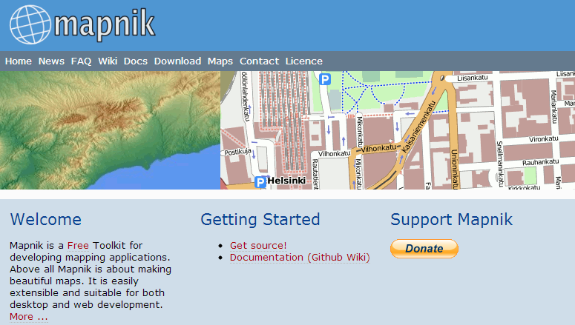
Implementing mapping applications
https://github.com/downloads/mapnik/mapnik/mapnik-v2.1.0.tar.bz2

Slide 9
// boost
#include <boost/operators.hpp>
// stl
#include <iomanip>
#include <sstream>
namespace mapnik {
template <typename T,int dim>
struct coord {
typedef T type;
};
template <typename T>
struct coord<T,2>
: boost::addable<coord<T,2>,
boost::addable2<coord<T,2>,T,
boost::subtractable<coord<T,2>,
boost::subtractable2<coord<T,2>,T,
boost::dividable2<coord<T,2>, T,
boost::multipliable2<coord<T,2>, T > > > > > >
{
typedef T type;
T x;
T y;
public:
coord()
: x(),y() {}
coord(T x,T y)
: x(x),y(y) {}
template <typename T2>
coord (const coord<T2,2>& rhs)
: x(type(rhs.x)),
y(type(rhs.y)) {}
#include <mapnik/distance.hpp>
#include <mapnik/ellipsoid.hpp>
// stl
#include <cmath>
namespace mapnik {
using std::atan2;
using std::cos;
using std::pow;
using std::sin;
using std::sqrt;
static const double deg2rad = 0.0174532925199432958;
static const double R = 6372795.0; // average great-circle radius of the earth
double great_circle_distance::operator() (coord2d const& pt0,
coord2d const& pt1) const
{
double lon0 = pt0.x * deg2rad;
double lat0 = pt0.y * deg2rad;
double lon1 = pt1.x * deg2rad;
double lat1 = pt1.y * deg2rad;
double dlat = lat1 - lat0;
double dlon = lon1 - lon0;
double sin_dlat = sin(0.5 * dlat);
double sin_dlon = sin(0.5 * dlon);
double a = pow(sin_dlat,2.0) + cos(lat0)*cos(lat1)*pow(sin_dlon,2.0);
double c = 2 * atan2(sqrt(a),sqrt(1 - a));
return R * c;
}
}
typedef coord<double,2> coord2d;
typedef coord<int,2> coord2i;
template <typename T2>
coord<T,2>& operator=(const coord<T2,2>& rhs)
{
if ((void*)this==(void*)&rhs)
{
return *this;
}
x=type(rhs.x);
y=type(rhs.y);
return *this;
}
template <typename T2>
bool operator==(coord<T2,2> const& rhs)
{
return x == rhs.x && y == rhs.y;
}
coord<T,2>& operator+=(coord<T,2> const& rhs)
{
x+=rhs.x;
y+=rhs.y;
return *this;
}

Slide 10
2) Design and implement a blackjack or twenty-one game using the randomization functions we have used for cards/suits. Allow playing against the computer as the “house.” Reveal all the cards at the end of a hand.
Card Draw() {
fulldeck.push_back(fulldeck[0]);
fulldeck.erase(fulldeck.begin());
return fulldeck[fulldeck.size()-1];
}; // Draw a card (sure, we return a card, but we shuffle it in the back immediately)
// Because you're not going to go through 52 cards in a 1v1 game!
int CountAces() {
int aces = 0;
for (unsigned i=0; i<fulldeck.size(); ++i)
if (fulldeck[i].Value == 11) aces++;
return aces;
}; // Count Aces
int CountCards() {
int cards = 0;
for (unsigned i=0; i<fulldeck.size(); ++i)
cards += fulldeck[i].Value;
return cards;
}; // Count Cards
int EvaluateHand() {
int hand = CountCards();
if (hand < 22) return hand;
int aces = CountAces();
if (aces == 0) return -1;
for (int i=0; i<aces; i++) {
hand -= 10;
if (hand < 22) return hand;
}
return -1; // you're out of aces, pal. suck it.
}; // return -1 if bust.
Deck() { }; // empty hands use default constructor
class Card {
public:
int Value;
char Suit;
std::string Name;
Card(int v, char s, std::string n):
Value(v),
Suit(s),
Name(n) {
};
Card(): Value(0), Suit('?'), Name("Error") { };
~Card() { };
};
class Deck {
public:
std::vector<Card> fulldeck;
void Shuffle() {
unsigned randocard;
srand(time(0));
for (unsigned i=fulldeck.size(); i>0; i--) {
if (i == 0) randocard = 0; // no, not very random is it?
else randocard = rand() % i;
fulldeck.push_back(fulldeck[randocard]);
fulldeck.erase(fulldeck.begin()+randocard);
} // for loop
}; // Shuffle

Slide 11
Deck(int cardnumber) { // a full deck wants a number
// even though we don't do anything with it
char tempsuit;
for (int suits=1; suits < 5; suits++) {
switch (suits) {
case 1: tempsuit = static_cast<char>(5);
break;
case 2: tempsuit = static_cast<char>(4);
break;
case 3: tempsuit = static_cast<char>(3);
break;
case 4: tempsuit = static_cast<char>(6);
break;
} // switch
for (int j=1; j < 14; j++)
switch (j) {
case 1: fulldeck.push_back( Card(11, tempsuit, "Ace") );
break;
case 2: fulldeck.push_back( Card(j, tempsuit, "2") );
break;
case 3: fulldeck.push_back( Card(j, tempsuit, "3") );
break;
case 4: fulldeck.push_back( Card(j, tempsuit, "4") );
break;
case 5: fulldeck.push_back( Card(j, tempsuit, "5") );
break;
case 6: fulldeck.push_back( Card(j, tempsuit, "6") );
break;
case 7: fulldeck.push_back( Card(j, tempsuit, "7") );
break;
case 8: fulldeck.push_back( Card(j, tempsuit, "8") );
break;
case 9: fulldeck.push_back( Card(j, tempsuit, "9") );
break;
case 10: fulldeck.push_back( Card(j, tempsuit, "10") );
break;
case 11: fulldeck.push_back( Card(10, tempsuit, "Jack") );
break;
case 12: fulldeck.push_back( Card(10, tempsuit, "Queen") );
break;
case 13: fulldeck.push_back( Card(10, tempsuit, "King") );
break;
} // switch
} // for suits
Shuffle();
} // end of constructor
~Deck() { };
void PrintDeck() {
for (unsigned i=0; i<fulldeck.size(); ++i)
cout << fulldeck[i].Name << " of " << fulldeck[i].Suit << ", ";
cout << "\b\b." << endl; // removing the trailing ", " and replacing it with a .
}
}; // end of Deck
int main()
{
bool again = true;
int money = 250;
int wager = 10;
char input = ' ';
Deck myhand, maindeck(52), dealer;
cout << "Welcome to the House of Rising Sun! Let's play Blackjack!" << endl;
cout << "Try to go as close as you dare to 21 points without going over." << endl;
while (again) {
myhand.fulldeck.clear();
dealer.fulldeck.clear();
maindeck.Shuffle();
cout << "Your funds: $" << money << ", wager per round: $" << wager << endl;
cout << "Dealer's hand: XX of X, ";
dealer.fulldeck.push_back(maindeck.Draw());
dealer.PrintDeck();
dealer.fulldeck.push_back(maindeck.Draw());
myhand.fulldeck.push_back(maindeck.Draw());
myhand.fulldeck.push_back(maindeck.Draw());
bool myturn = true;
while (myturn) {
cout << "My hand: ";
myhand.PrintDeck();
cout << "My points: ";
if ( myhand.EvaluateHand() != -1 ) {
cout << myhand.EvaluateHand() << endl;
cout << "Draw another card? y/n" << endl;
cin >> input;
if ((input == 'y') || (input == 'Y'))
myhand.fulldeck.push_back(maindeck.Draw());
else {
cout << "Dealer reveals his hand: ";
dealer.PrintDeck();
cout << "Dealer always stops at 17 unless he beats you." << endl;
cout << "Dealer's points: " << dealer.EvaluateHand() << endl;

Slide 12
myturn = false;
bool dealerturn = true;
while (dealerturn)
if (dealer.EvaluateHand() == -1) {
cout << "Dealer went bust!" << endl;
dealerturn = false;
} else if ((dealer.EvaluateHand() < 17) && (dealer.EvaluateHand() < myhand.EvaluateHand())) {
dealer.fulldeck.push_back(maindeck.Draw());
cout << "Dealer chooses to draw a card. Dealer\'s new hand: ";
dealer.PrintDeck();
}
else {
cout << "Dealer stops at " << dealer.EvaluateHand() << " points. \n";
dealerturn = false;
} // end of if..else and while loop
} // end of player's turn loop
}
else {
cout << "Bust!\n\n";
myturn = false;
} // if EvaluateHand == -1 else
} // my turn is over
// and the winner is?
if ((myhand.EvaluateHand() > dealer.EvaluateHand() )) {
cout << "You win $" << wager <<". " << endl;
money += wager;
}
else if ((myhand.EvaluateHand() == -1) || (myhand.EvaluateHand() < dealer.EvaluateHand()) ) {
cout << "You lose $" << wager <<". "<< endl;
money -= wager;
}
else if (myhand.EvaluateHand() == dealer.EvaluateHand())
cout << "You tie with the dealer, it's a draw." << endl;
cout << "Continue? y/n" << endl;
cin >> input;
if ( (input == 'n') || (input == 'N') || (money < wager) )
again = false;
}
cout << "You leave the House of Rising Sun with $" << money << endl;
system("Pause");
return 0;
}

Slide 13
4) Make a dice rolling program that rolls two dice of any number of sides. Bonus: Implement a standard dice game of your choice (http://en.wikipedia.org/wiki/List_of_dice_games).
#include "stdafx.h"
#include <iostream>
#include <iomanip> // for time
#include <cstdlib> // for random
int main(){
bool rollAgain;
char c_response;
using namespace std;
do{
int i_numOfSides1, i_numOfSides2;
srand( time(0));
cout << "How many sides are on your dice? Please enter two numbers the another with \
a 'Space' between. (Exm: 6 6 or 6 12)";
cin >> i_numOfSides1 >> i_numOfSides2;
cout << "First die rolls a " << ( 1 + rand() % i_numOfSides1 ) << endl;
cout << "Second die rolls a " << ( 1 + rand() % i_numOfSides2 ) << endl;
cout << "Start again? (Exm: y or n) ";
cin >> c_response;
if ( c_response == 'y')
rollAgain = true;
else
rollAgain = false;
} while ( rollAgain );
}

Slide 14
/*
6) Write a concatenate function that takes a variable number of arguments (may or may not
be of different data types) and returns their concatenation as a string.
*/
#include "stdafx.h"
#include <string>
#include <stdarg.h>
#include <iostream>
#include <sstream>
using namespace std;
string concatenate( char *format, ... ){
va_list argptr;
va_start( argptr, format);
stringstream ss;
while ( *format != '\0' ) {
// string
if ( *format == 's' )
{
char* s = va_arg(argptr, char *);
ss << s << " ";
}
// character
else if ( *format == 'c' )
{
char c = (char) va_arg(argptr, int);
ss << c << " ";
}
// integer
else if ( *format == 'd' ){
int d = va_arg(argptr, int);
ss << d << " ";
}
*format++;
}
va_end( argptr );
return ss.str();
}
int main( int argc, char *argv[]){
string test = concatenate("scd", "This is a string", 'X', 34);
cout << "calling concatenate(\"scd\", \"This is a string\", 'X', 34) : " << test << endl;
return 0;
}

Slide 15
8) Write a .cpp file that uses a function prototype and default parameters for a function.
#include "stdafx.h"
#include <iostream>
#include <string>
using namespace std;
string myStringFunction( string ); // the function prototype for a function that accepts string
// params and returns a string
int _tmain(int argc, _TCHAR* argv[])
{
string s_response;
cout << "Enter a line of text." << endl;
getline (cin, s_response); // grab the entire line of user input
cout << "Here is your line returned after passing through the function.\n" <<
myStringFunction( s_response ) << endl; // calls the function
return 0;
}
string myStringFunction( string aString )
{
cout << "inside myStringFunction\n";
aString += " Hello World.";
return aString;
}

Slide 16
You can download the source code for all the textbook examples here:
"Starting Out with C++: From Control Structures through Objects, 7/e"
Gaddis
ISBN: 0132576252
Source code and appendices can be found at http://media.pearsoncmg.com/ph/esm/ecs_gaddis_sowcpp_7/CS Support/Assorted.zip

Slide 17
For advanced students who want a challenge
Download, install, and compile Ogre3D
http://www.ogre3d.org/tikiwiki/Setting+Up+An+Application+-+Visual+Studio
OR:
http://www.unrealengine.com/udk/
OR:
http://www.garagegames.com/products/torque-3d/overview

Slide 18
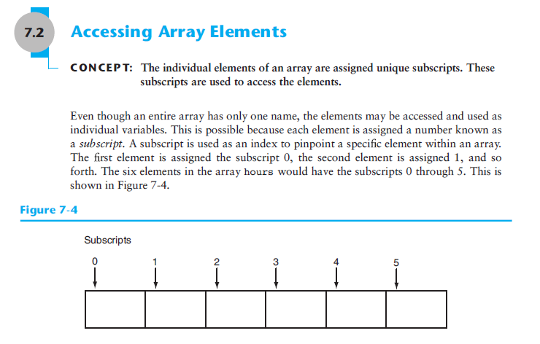

Slide 19
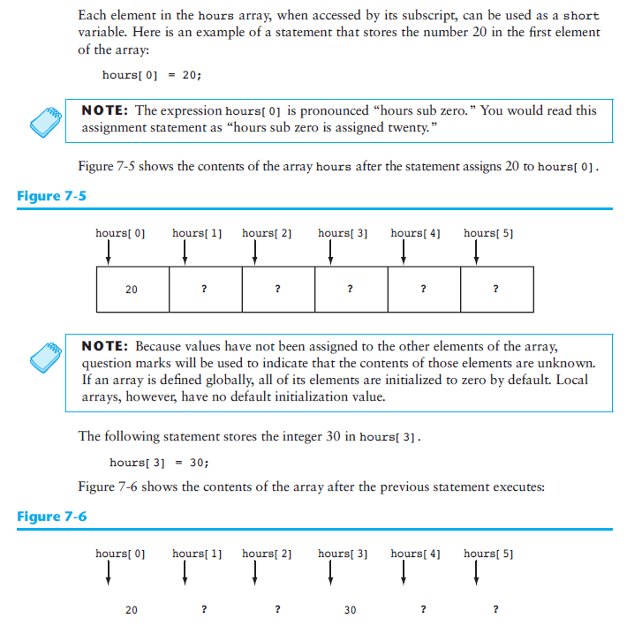

Slide 20
// GlobalvsLocalInitialization.cpp – demonstrates global vs. local initialization
#include <iostream>
#include <string>
using namespace std;
double globaldbl[10];
int main(){
int arry[10];
cout << arry[3] << " " << arry[4] << " " << arry[5] << endl;
cout << globaldbl[3] << " " << globaldbl[4] << " " << globaldbl[5] << endl;
return 0;
}
$ ./GlobalvsLocalInitialization.exe
1 2293028 2
0 0 0

Slide 21
No bounds checking in C++ for arrays
#include <iostream>
#include <string>
using namespace std;
double globaldbl[10];
int main(){
int arry[10];
cout << arry[3] << " " << arry[4] << " " << arry[5] << endl;
cout << globaldbl[3] << " " << globaldbl[4] << " " << globaldbl[5] << endl;
cout << arry[13] << " " << arry[14] << " " << arry[15] << endl;
return 0;
}
./NoBoundsChecking.exe
1 2293028 2
0 0 0
1629971688 47 0

Slide 22
Reading data in a file into an array
// This program reads data from a file into an array.
#include <iostream>
#include <fstream>
using namespace std;
int main()
{
const int ARRAY_SIZE = 10; // Array size
int numbers[ARRAY_SIZE]; // Array with 10 elements
int count = 0; // Loop counter variable
ifstream inputFile; // Input file stream object
// Open the file.
inputFile.open("TenNumbers.txt");
// Read the numbers from the file into the array.
while (count < ARRAY_SIZE && inputFile >> numbers[count])
count++;
// Close the file.
inputFile.close();
// Display the numbers read:
cout << "The numbers are: ";
for (count = 0; count < ARRAY_SIZE; count++)
cout << numbers[count] << " ";
cout << endl;
return 0;
}

Slide 23
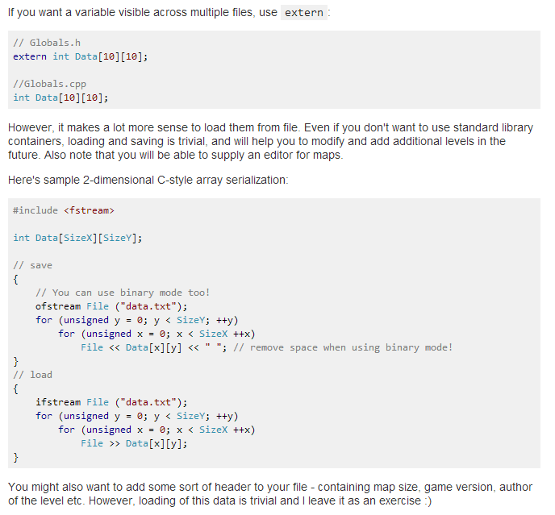
Loading data from file to 2D Data Array

Slide 24
Writing/loading data to/from a 2D Data Array
// Save
#include "stdafx.h"
#include <iostream>
#include <string>
#include <fstream>
using namespace std;
const int SizeX=2;
const int SizeY=2;
int Data[SizeX][SizeY]={{1,2},{3,4}};
int main(){
// You can use binary mode too
ofstream File ("mydata.txt");
for (unsigned y = 0; y < SizeY; ++y)
for (unsigned x = 0; x < SizeX; ++x)
File << Data[x][y] << " ";
// remove space when using binary mode!
return 0;
}
// Load
#include "stdafx.h"
#include <iostream>
#include <string>
#include <fstream>
using namespace std;
const int SizeX=2;
const int SizeY=2;
int Data[SizeX][SizeY]={{1,2},{3,4}};
int main(){
// You can use binary mode too!
// ofstream File ("mydata.txt");
ifstream File ("mydata.txt");
for (unsigned y = 0; y < SizeY; ++y)
for (unsigned x = 0; x < SizeX; ++x)
File >> Data[x][y];
cout << Data[0][0] << endl;
system("PAUSE");
return 0;
}

Slide 25
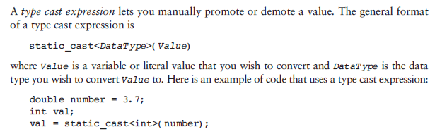
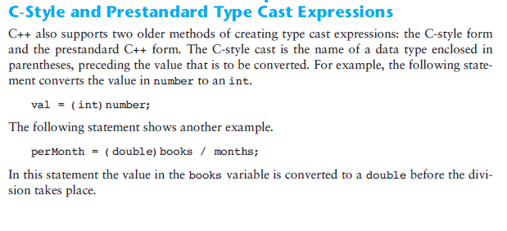
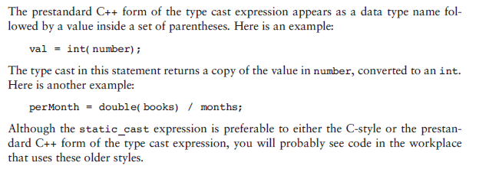
Type Casting! – converting from one data type to another

Slide 26
Class Activity, Type Casting
#include "stdafx.h"
// This program uses a type cast expression to print a character
// from a number.
#include <iostream>
using namespace std;
int main()
{
int number = 65;
// Display the value of the number variable.
cout << number << endl;
// Display the value of number converted to
// the char data type.
cout << static_cast<char>(number) << endl;
system("PAUSE");
return 0;
}

Slide 27
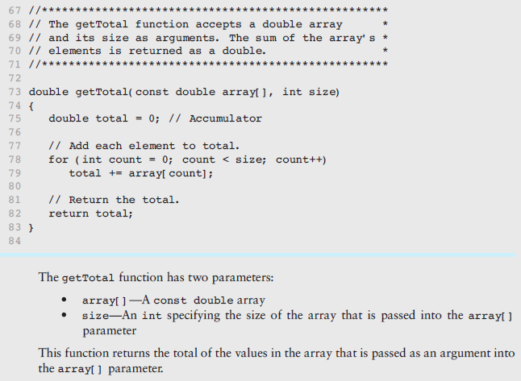
Functions on arrays, total, lowest, etc.

Slide 28
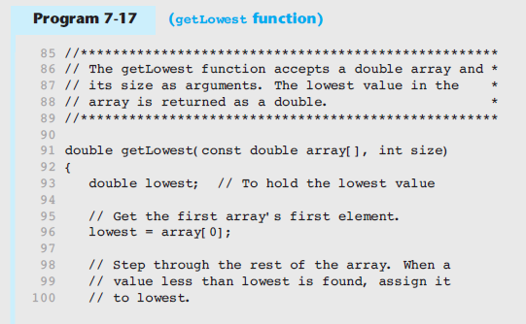
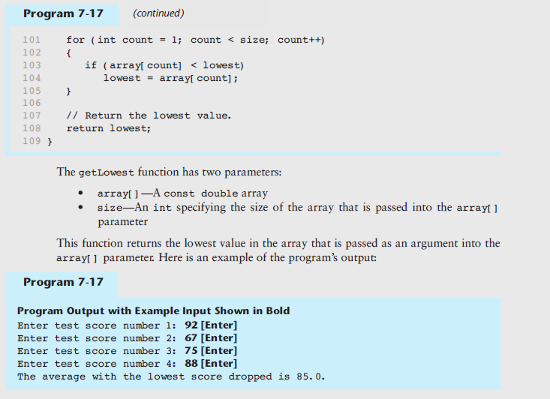

Slide 29
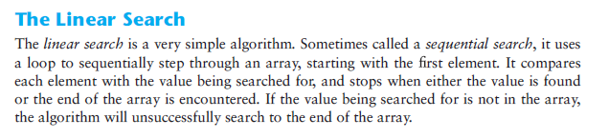
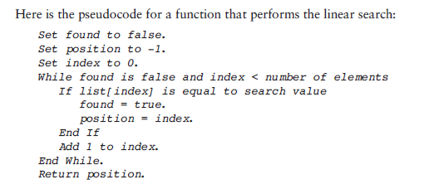
Searching an array

Slide 30
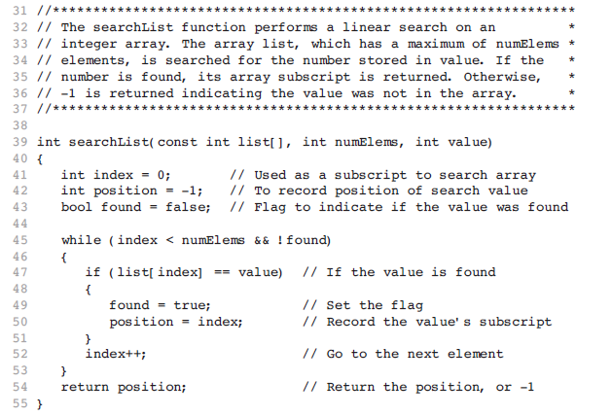

Slide 31
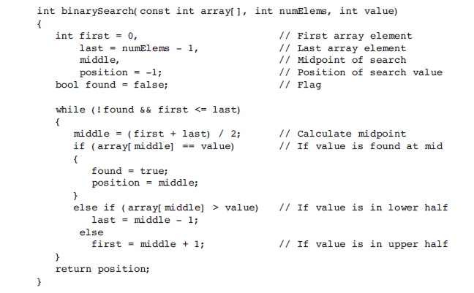
Binary Search (requires sorted input)

Slide 32
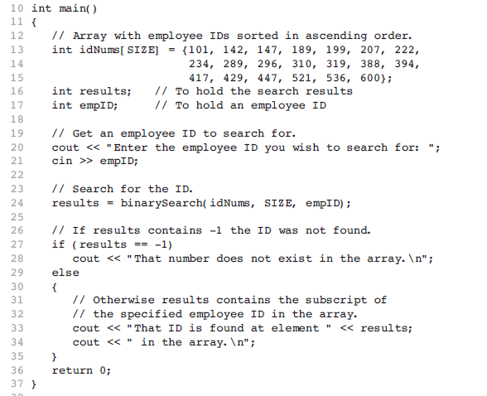
Working with the binarySearch() function

Slide 33
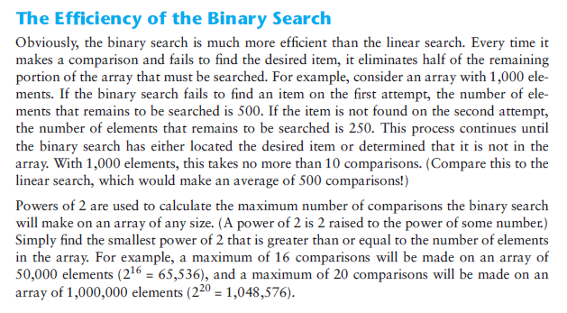
2^10 = 1024

Slide 34
Class Exercise: Binary Search
// This program demonstrates the binarySearch function, which
// performs a binary search on an integer array.
#include <iostream>
using namespace std;
// Function prototype
int binarySearch(const int [], int, int);
const int SIZE = 20;
int main()
{
// Array with employee IDs sorted in ascending order.
int idNums[SIZE] = {101, 142, 147, 189, 199, 207, 222,
234, 289, 296, 310, 319, 388, 394,
417, 429, 447, 521, 536, 600};
int results; // To hold the search results
int empID; // To hold an employee ID
// Get an employee ID to search for.
cout << "Enter the employee ID you wish to search for: ";
cin >> empID;
// Search for the ID.
results = binarySearch(idNums, SIZE, empID);
// If results contains -1 the ID was not found.
if (results == -1)
cout << "That number does not exist in the array.\n";
else
{
// Otherwise results contains the subscript of
// the specified employee ID in the array.
cout << "That ID is found at element " << results;
cout << " in the array.\n";
}
return 0;
}
//***************************************************************
// The binarySearch function performs a binary search on an *
// integer array. array, which has a maximum of size elements, *
// is searched for the number stored in value. If the number is *
// found, its array subscript is returned. Otherwise, -1 is *
// returned indicating the value was not in the array. *
//***************************************************************
int binarySearch(const int array[], int size, int value)
{
int first = 0, // First array element
last = size - 1, // Last array element
middle, // Mid point of search
position = -1; // Position of search value
bool found = false; // Flag
while (!found && first <= last)
{
middle = (first + last) / 2; // Calculate mid point
if (array[middle] == value) // If value is found at mid
{
found = true;
position = middle;
}
else if (array[middle] > value) // If value is in lower half
last = middle - 1;
else
first = middle + 1; // If value is in upper half
}
return position;
}

Slide 35
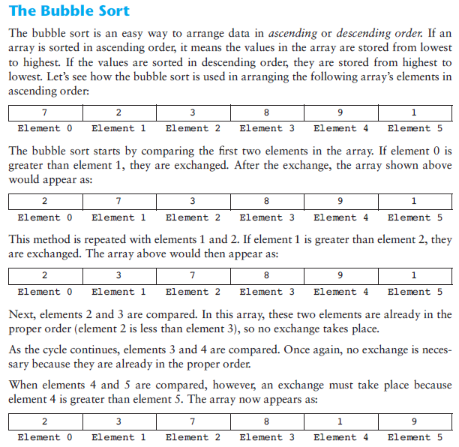
Sorting an array

Slide 36
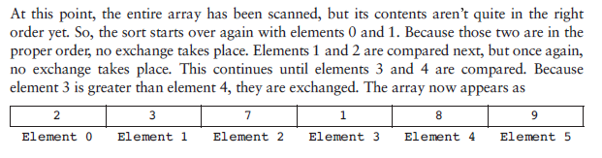
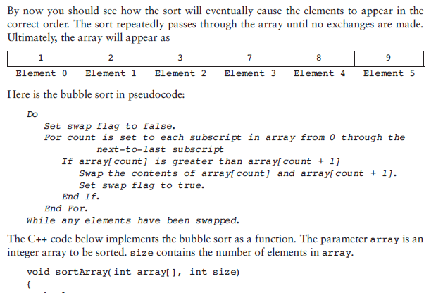
Sorting an array, continued

Slide 37
Class Exercise: Bubble Sort
//***********************************************************
// Definition of function sortArray *
// This function performs an ascending order bubble sort on *
// array. size is the number of elements in the array. *
//***********************************************************
void sortArray(int array[], int size)
{
bool swap;
int temp;
do
{
swap = false;
for (int count = 0; count < (size - 1); count++)
{
if (array[count] > array[count + 1])
{
temp = array[count];
array[count] = array[count + 1];
array[count + 1] = temp;
swap = true;
}
}
} while (swap);
}
//*************************************************************
// Definition of function showArray. *
// This function displays the contents of array. size is the *
// number of elements. *
//*************************************************************
void showArray(const int array[], int size)
{
for (int count = 0; count < size; count++)
cout << array[count] << " ";
cout << endl;
}
// This program uses the bubble sort algorithm to sort an
// array in ascending order.
#include <iostream>
using namespace std;
// Function prototypes
void sortArray(int [], int);
void showArray(const int [], int);
int main()
{
// Array of unsorted values
int values[6] = {7, 2, 3, 8, 9, 1};
// Display the values.
cout << "The unsorted values are:\n";
showArray(values, 6);
// Sort the values.
sortArray(values, 6);
// Display them again.
cout << "The sorted values are:\n";
showArray(values, 6);
return 0;
}

Slide 38
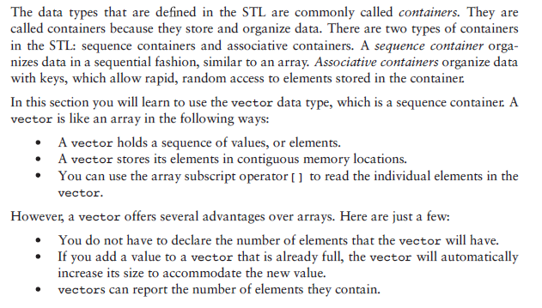
Vectors vs. Arrays

Slide 39
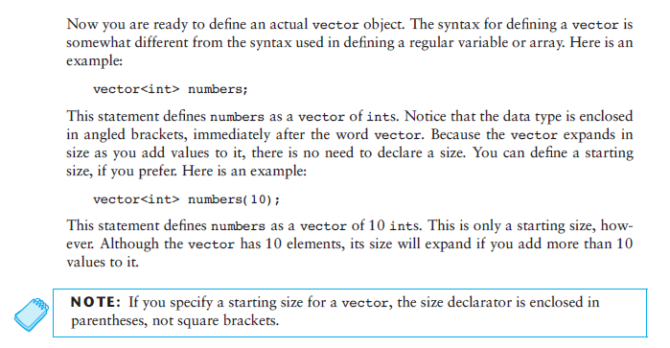

Slide 40
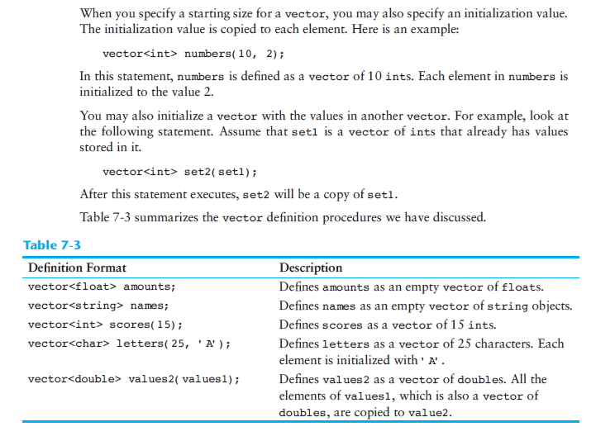

Slide 41
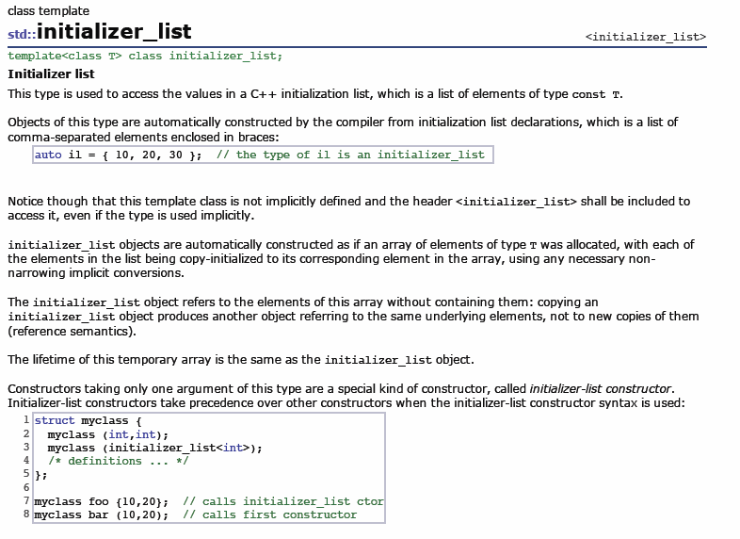

Slide 42
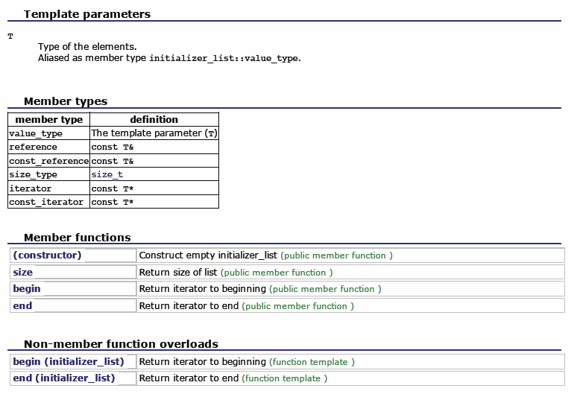

Slide 43
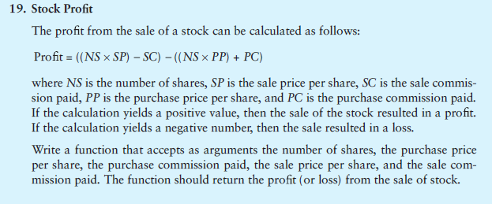
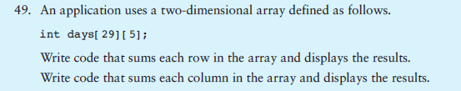
Homework #3 Exercises for next Monday (pick 2)
1)
2)

